Slide 1
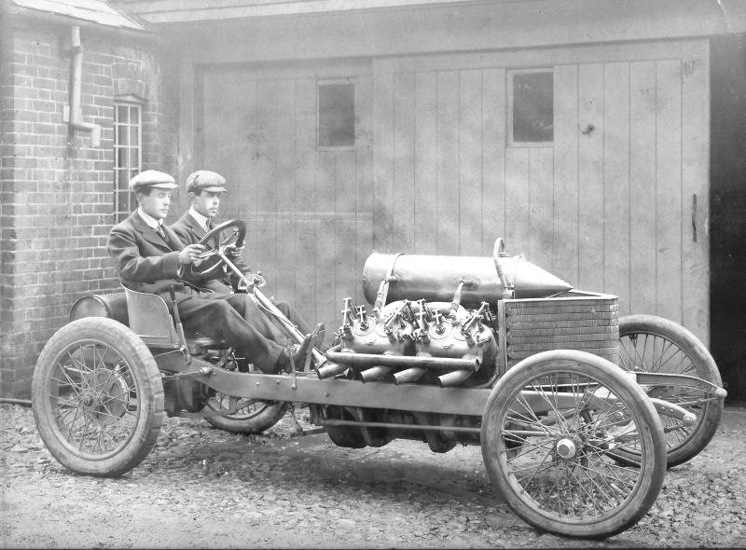
The past is a foreign land – they do things differently there!

Slide 2
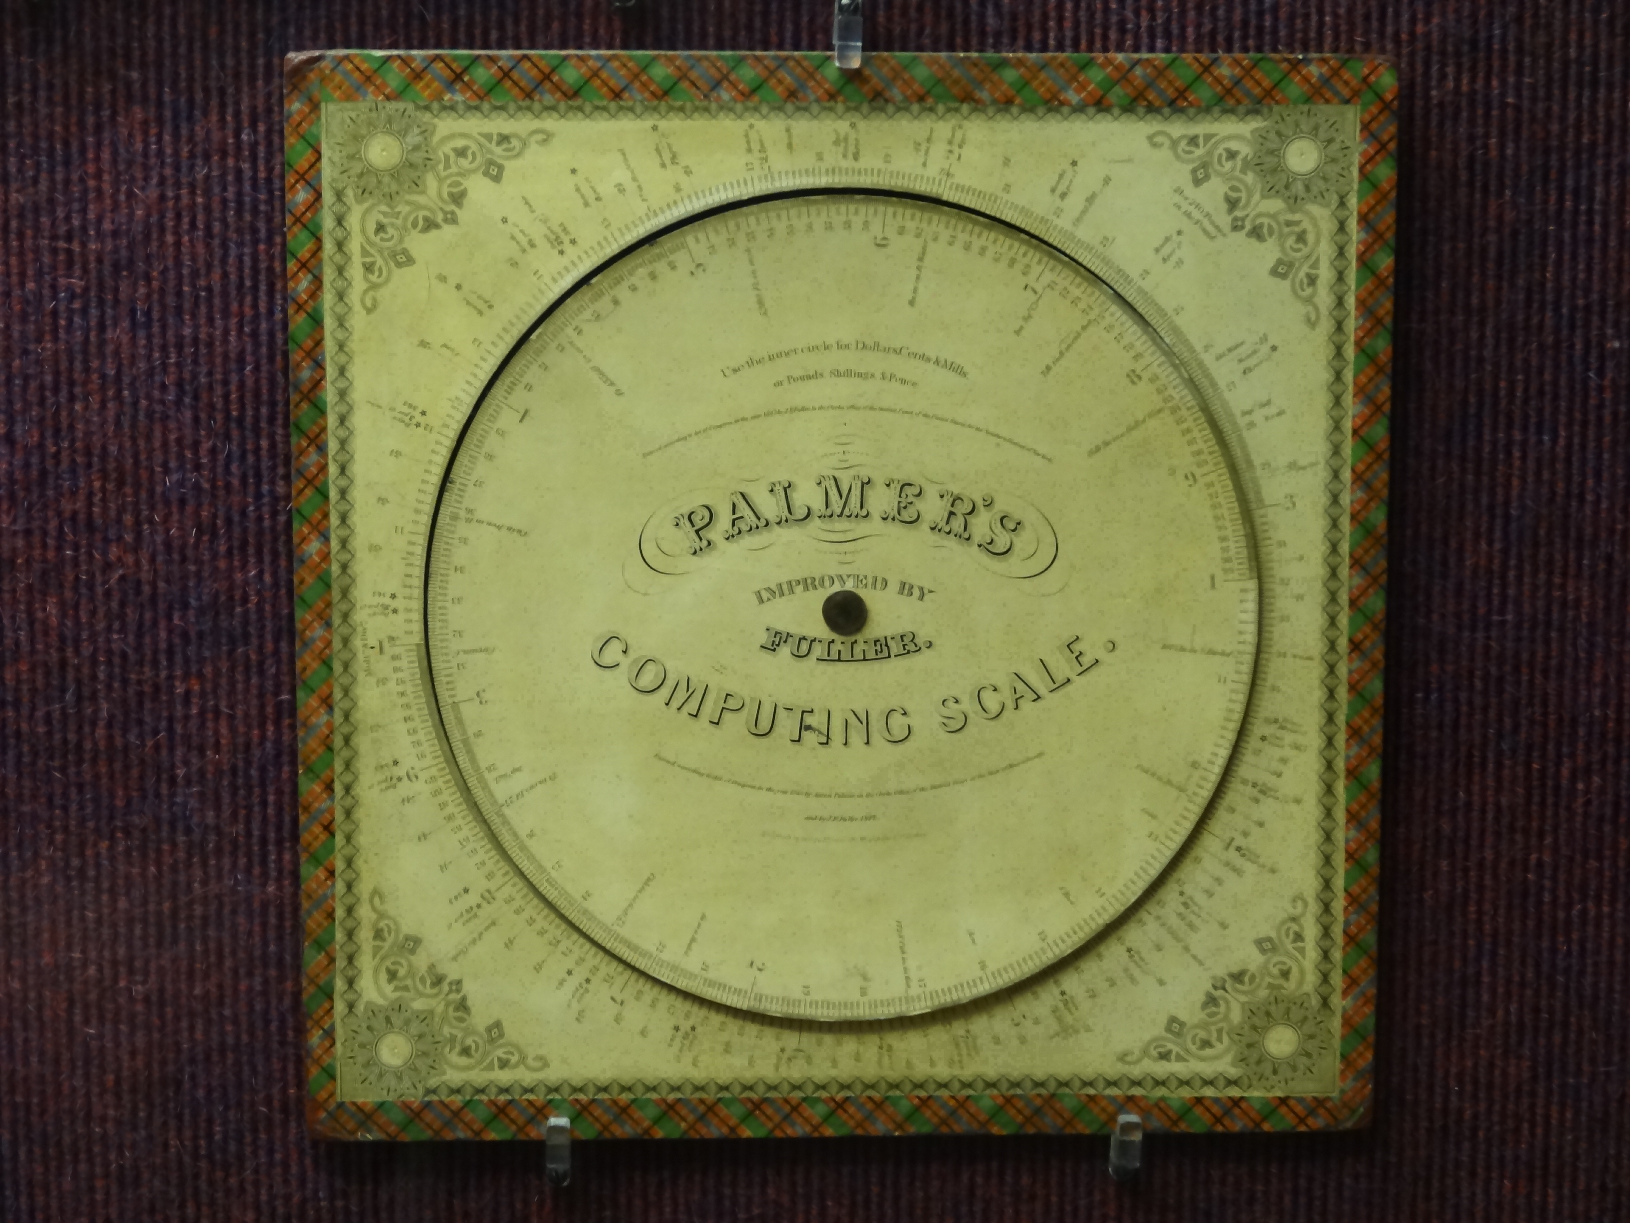
The Computing Evolutionary Path
1843 – Palmer’s Patented Slide Rule

Slide 3
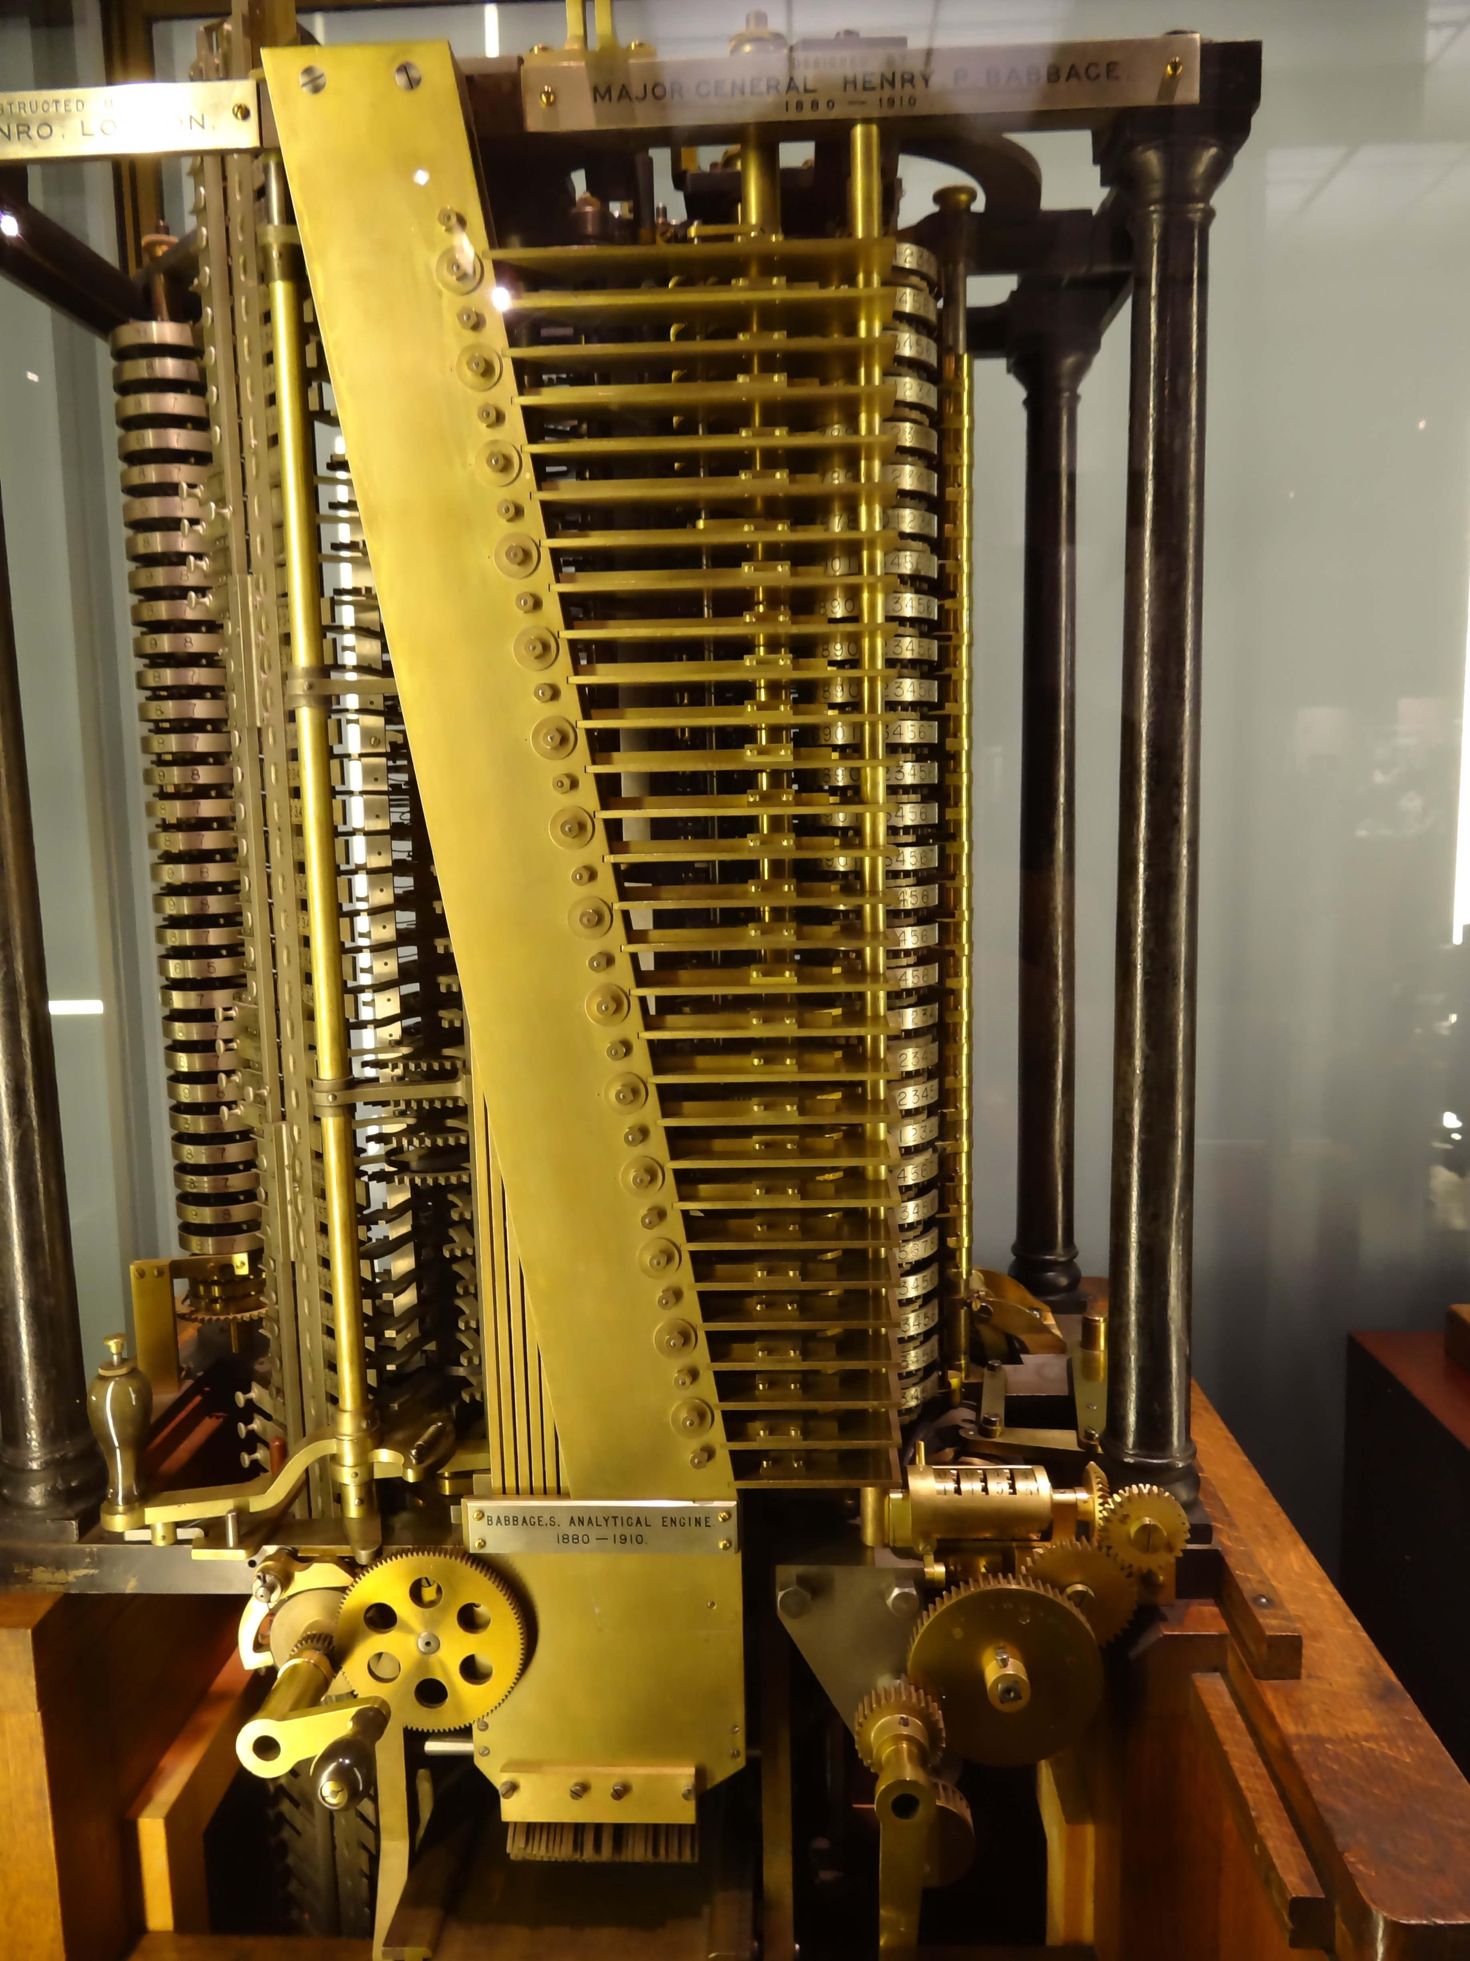
The Computing Evolutionary Path
1837 – Babbage’s Analytical Engine

Slide 4
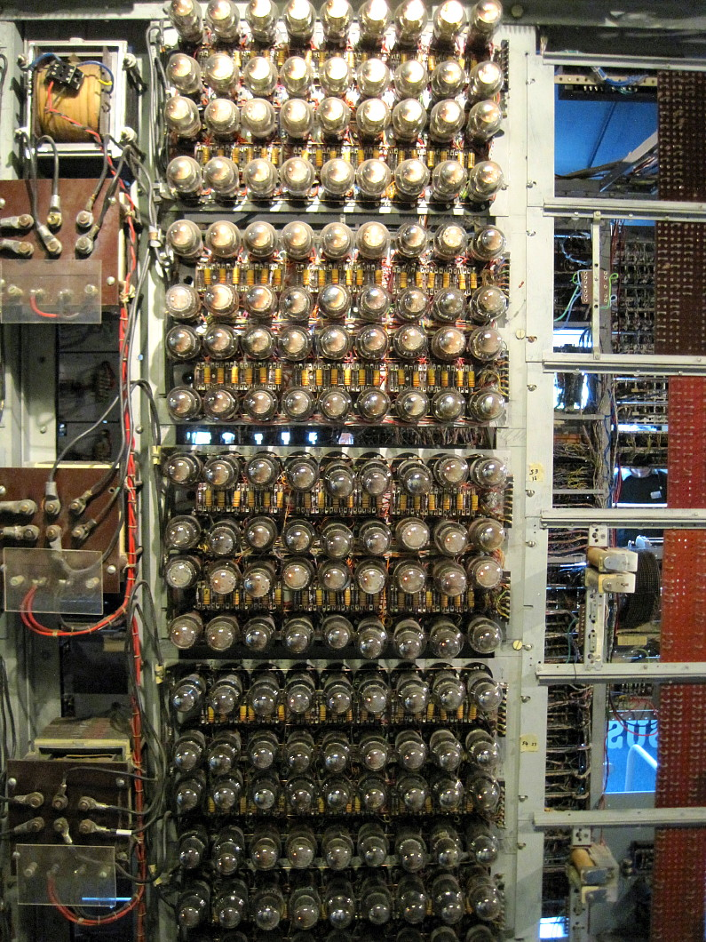
The Computing Evolutionary Path
1943 – Colossus Computer

Slide 5

The Computing Evolutionary Path
1946 – Eniac – a numeric calculator

Slide 6
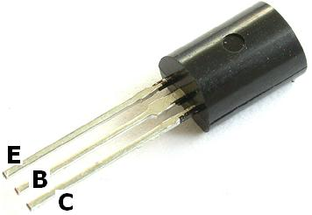
The Computing and Comms Evolutionary Path
1947– The Transistor

Slide 7

The Computing Evolutionary Path
1964 IBM 360 – commercial computing
1964: IBM 360

Slide 8
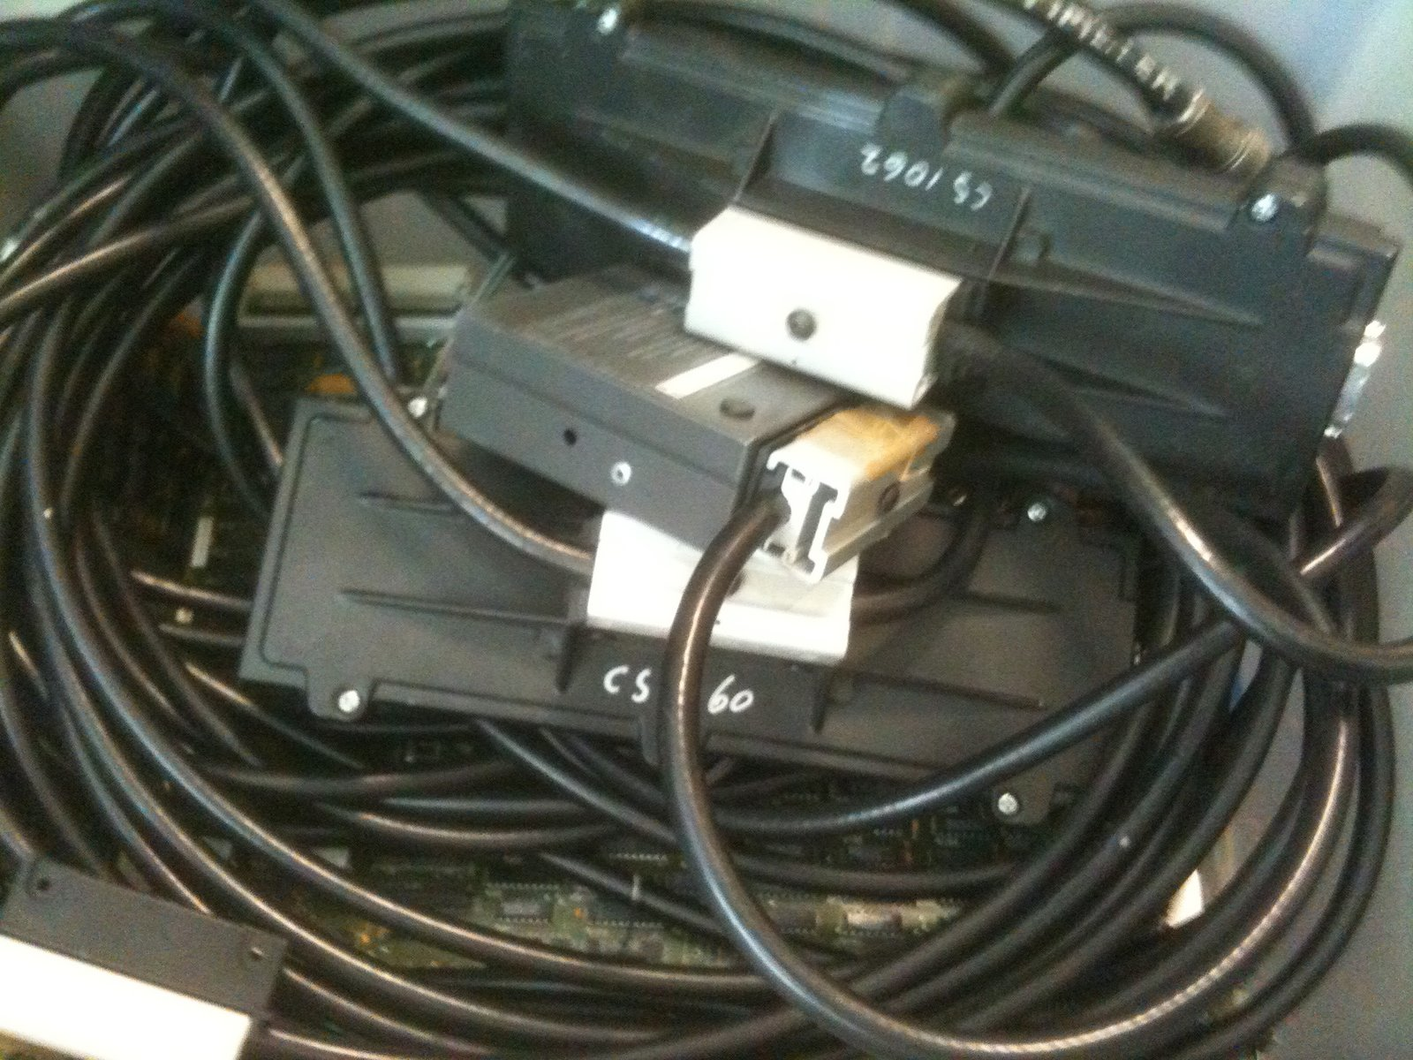
The Computing and Comms Evolutionary Path
1976 Ethernet

Slide 9

The Computing Evolutionary Path
The Computing Evolutionary Path
1976 CRAY-1 – “super” computing

Slide 10

The Computing Evolutionary Path
The Computing Evolutionary Path
A fork in the road:
1976 – Apple-1 “personal” computing
1976: Apple I

Slide 11
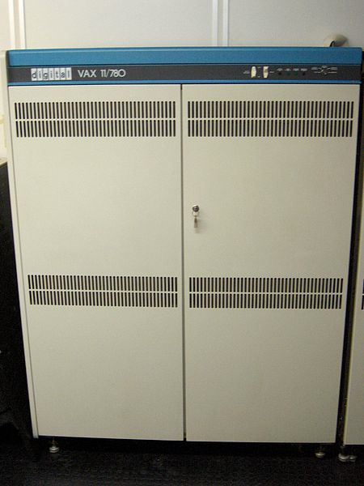
The Computing Evolutionary Path
The Computing and Comms Evolutionary Path
Wide Area Packet Networks
1982 – DECnet Phase IV

Slide 12

The Computing Evolutionary Path
1984 – Mac - visual computing

Slide 13
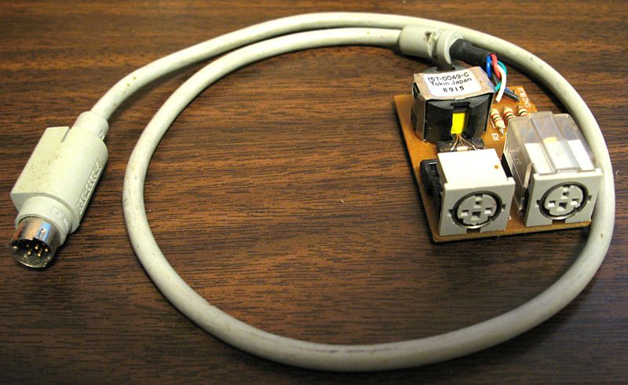
The Computing and Comms Evolutionary Path
1985 – Appletalk

Slide 14
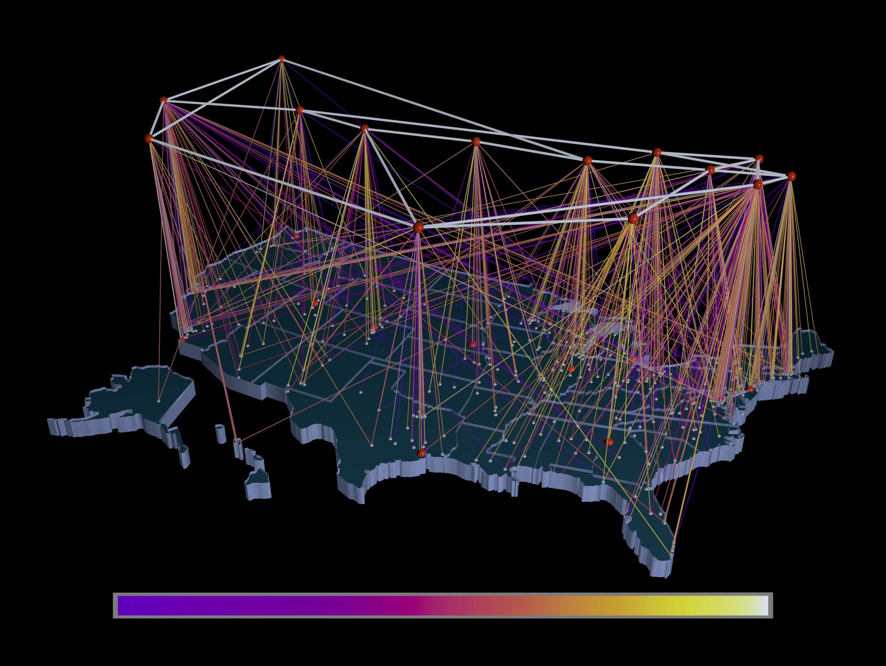
The Computing and Comms Evolutionary Path
1988 – TCP/IP and the NSFNET

Slide 15
Which brings us to 1989
(Or thereabouts)

Slide 16
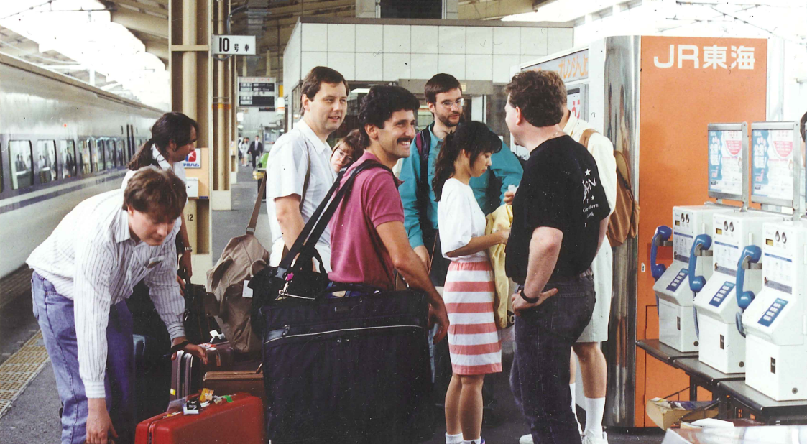
Somewhere in Japan…

Slide 17
A few familiar faces

Slide 18
A few familiar faces

Slide 19
A few familiar faces

Slide 20
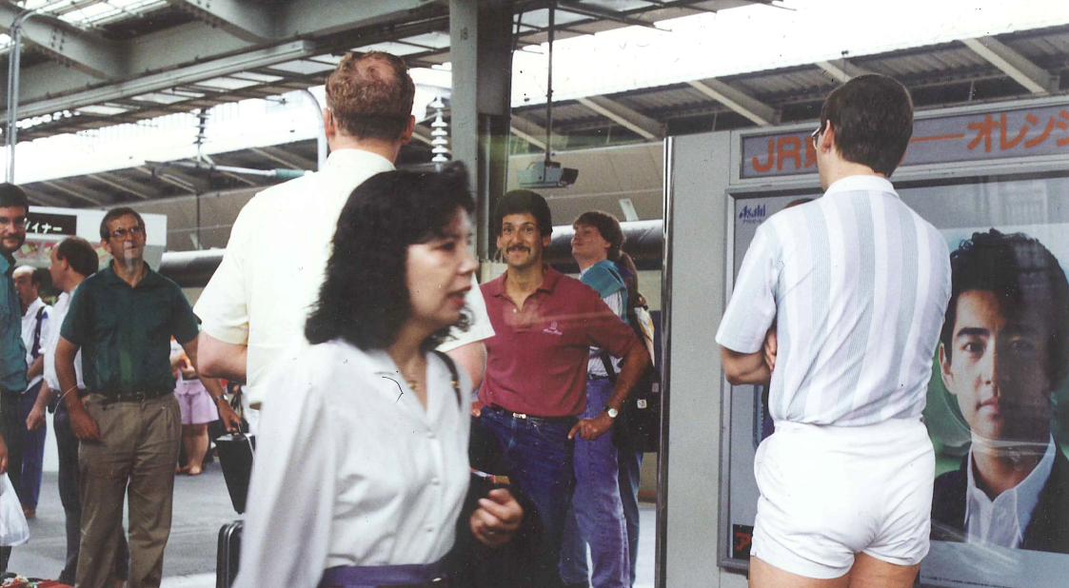
Fashions have changed since then (thank god!)

Slide 21
What were we talking about then?

Slide 22
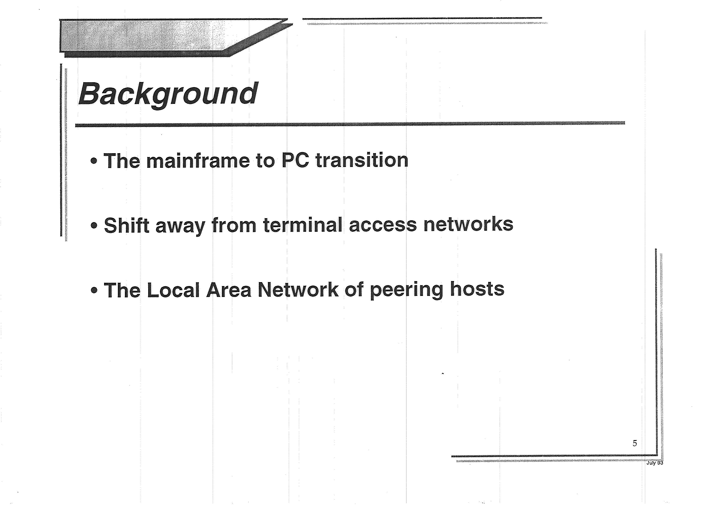

Slide 23
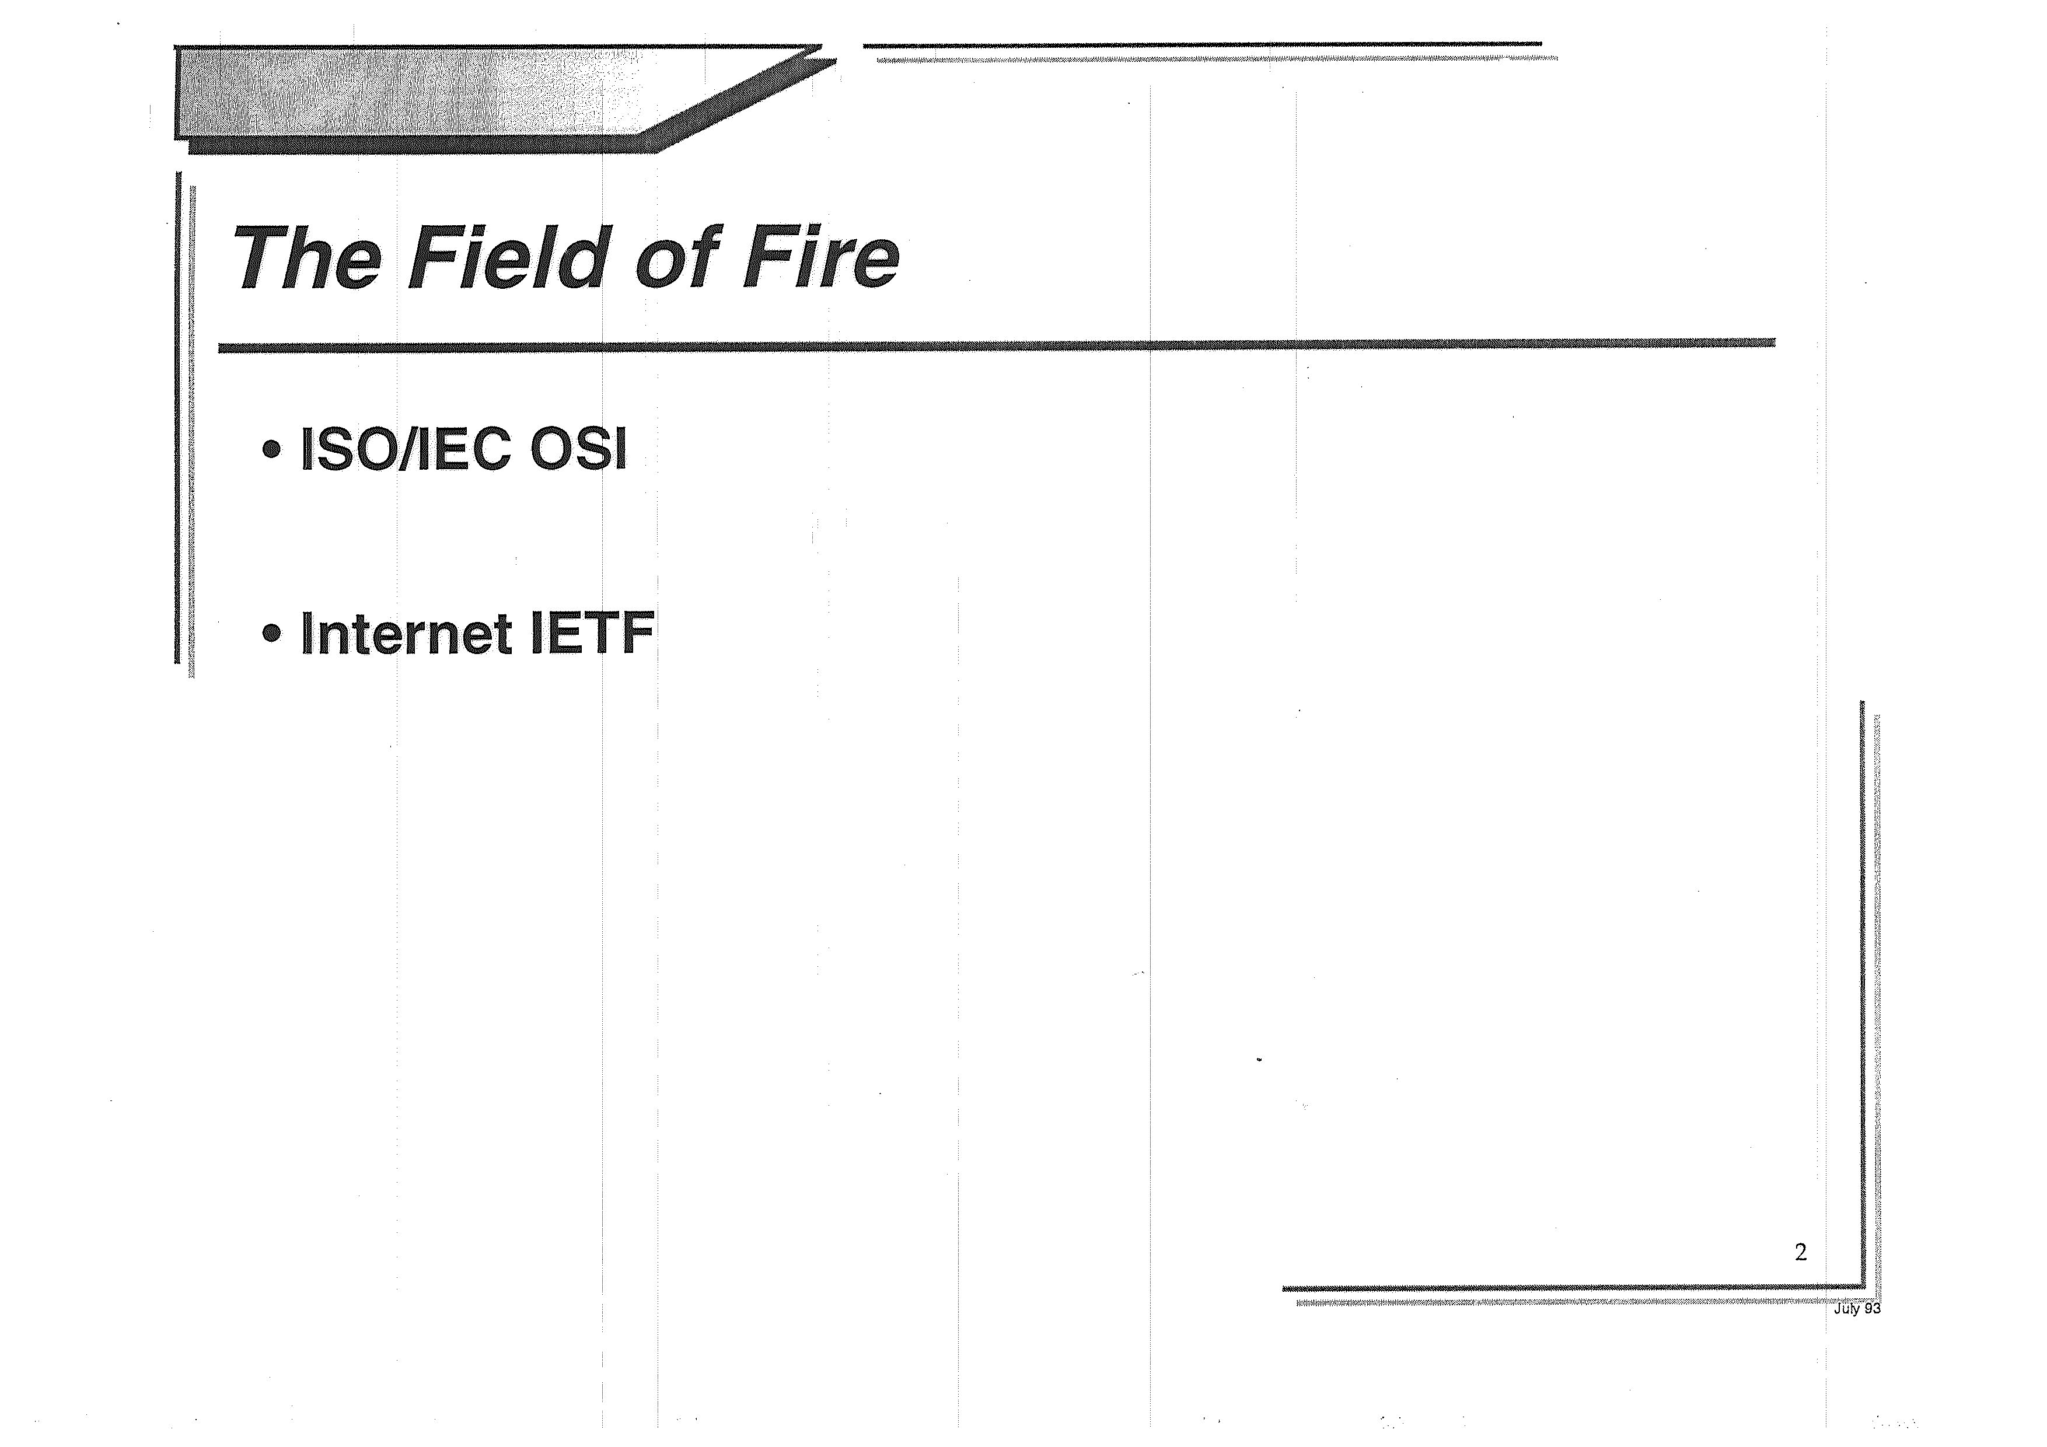

Slide 24
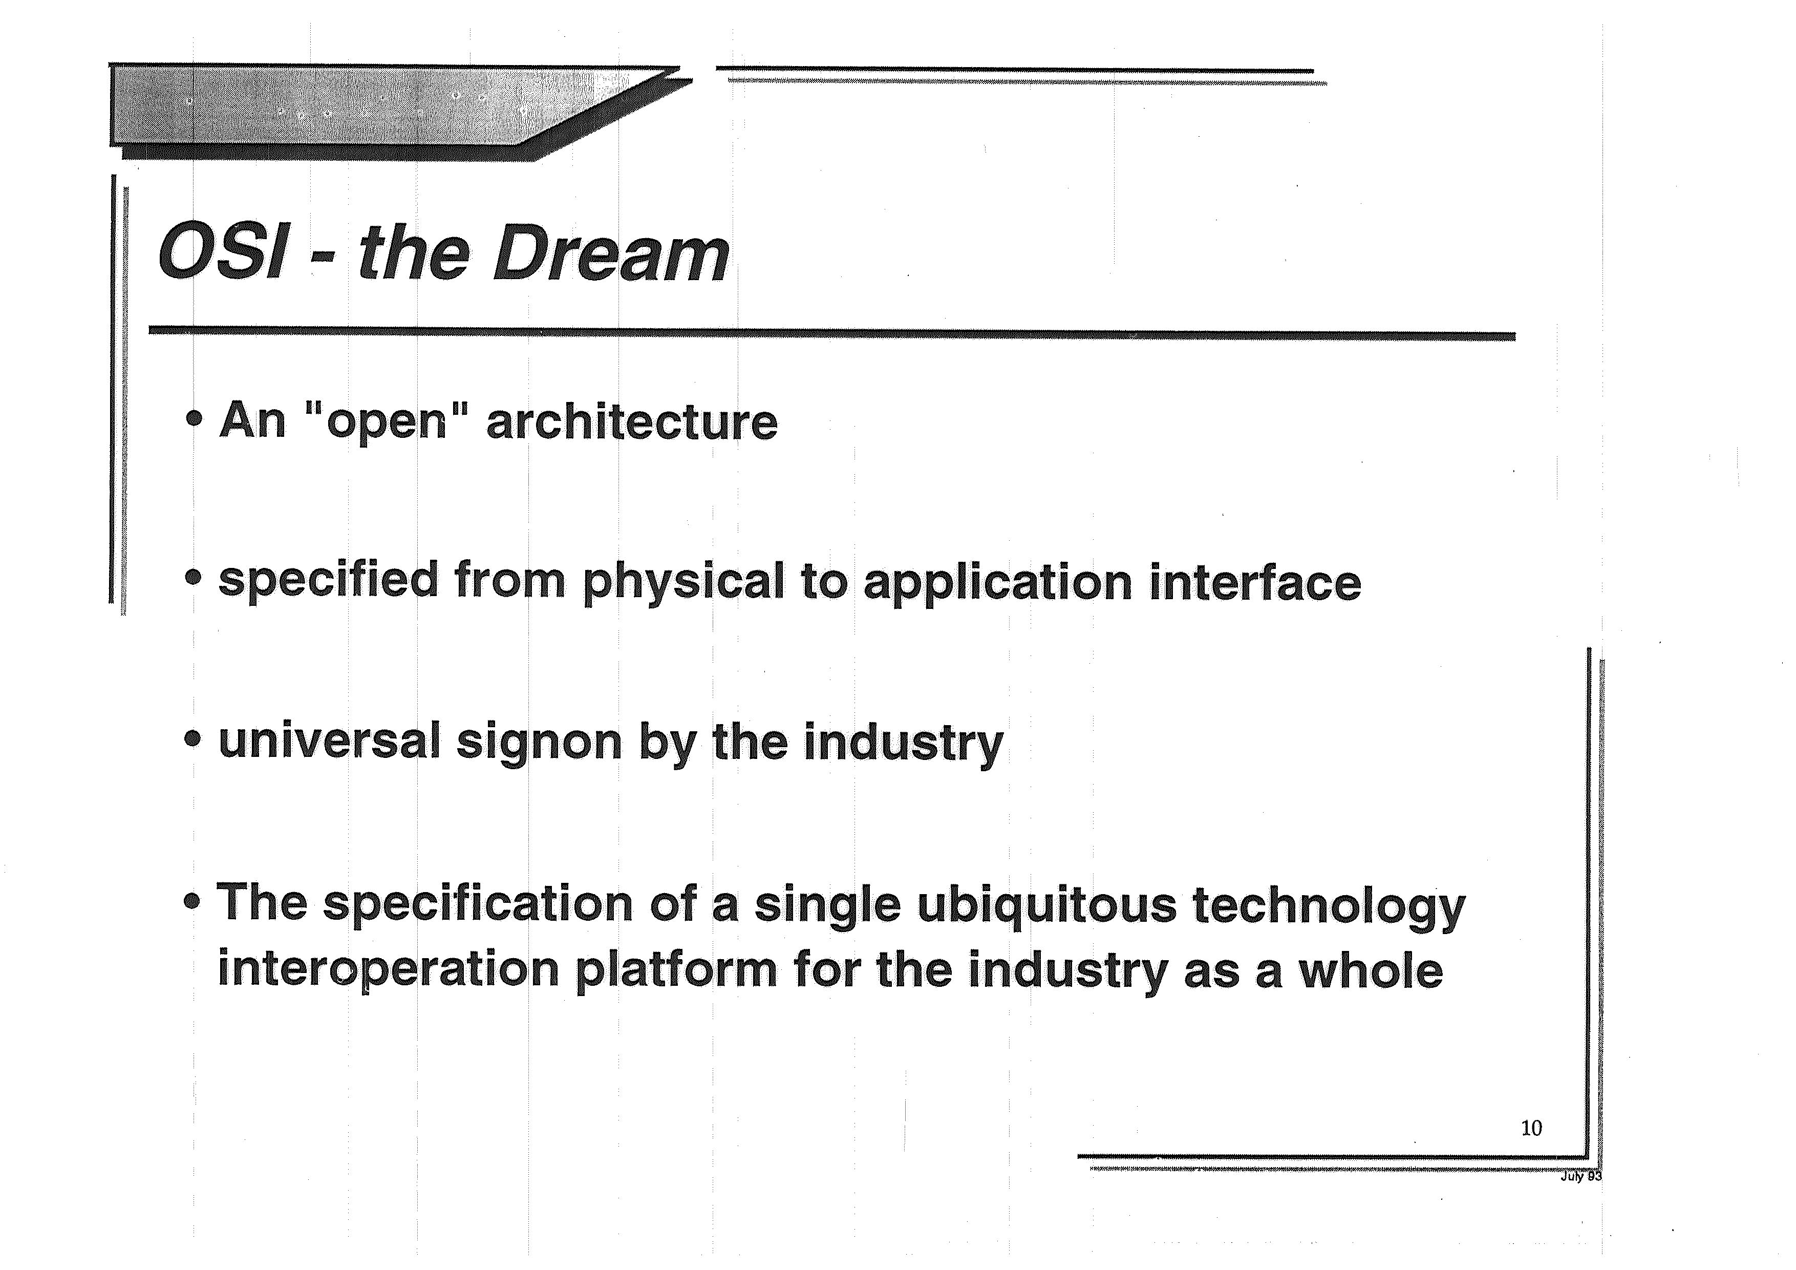

Slide 25
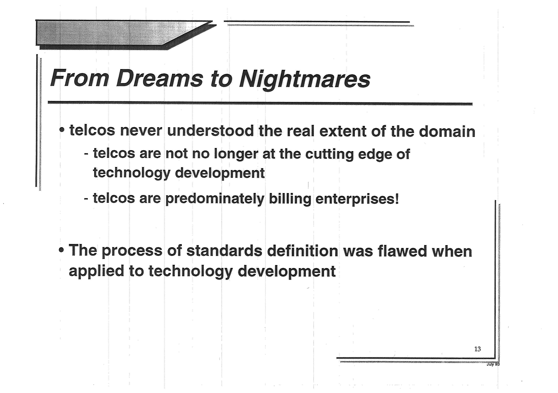

Slide 26
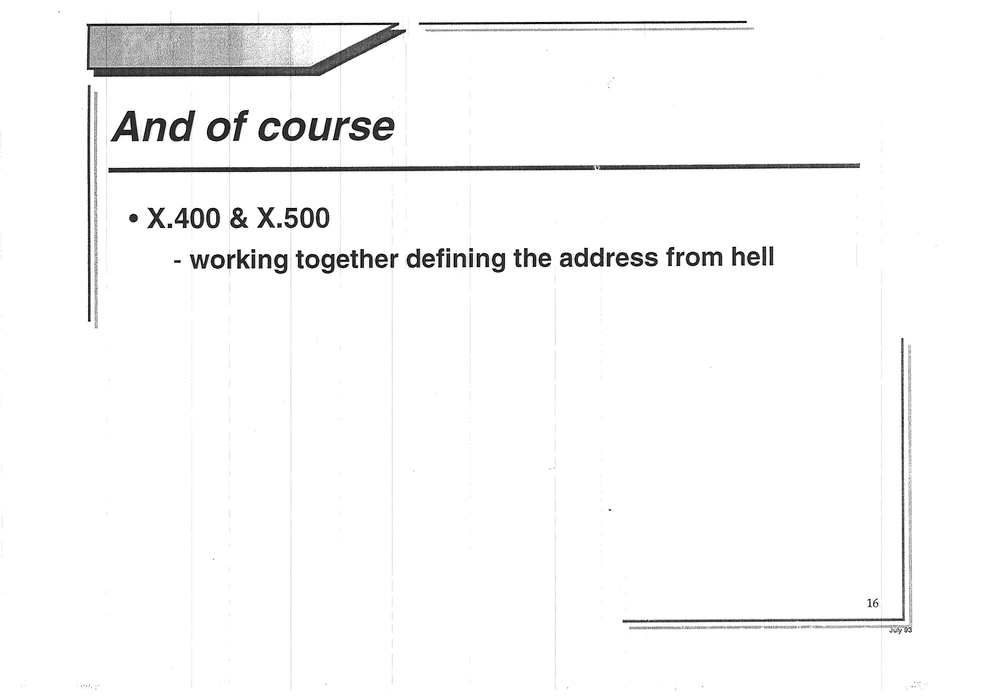

Slide 27
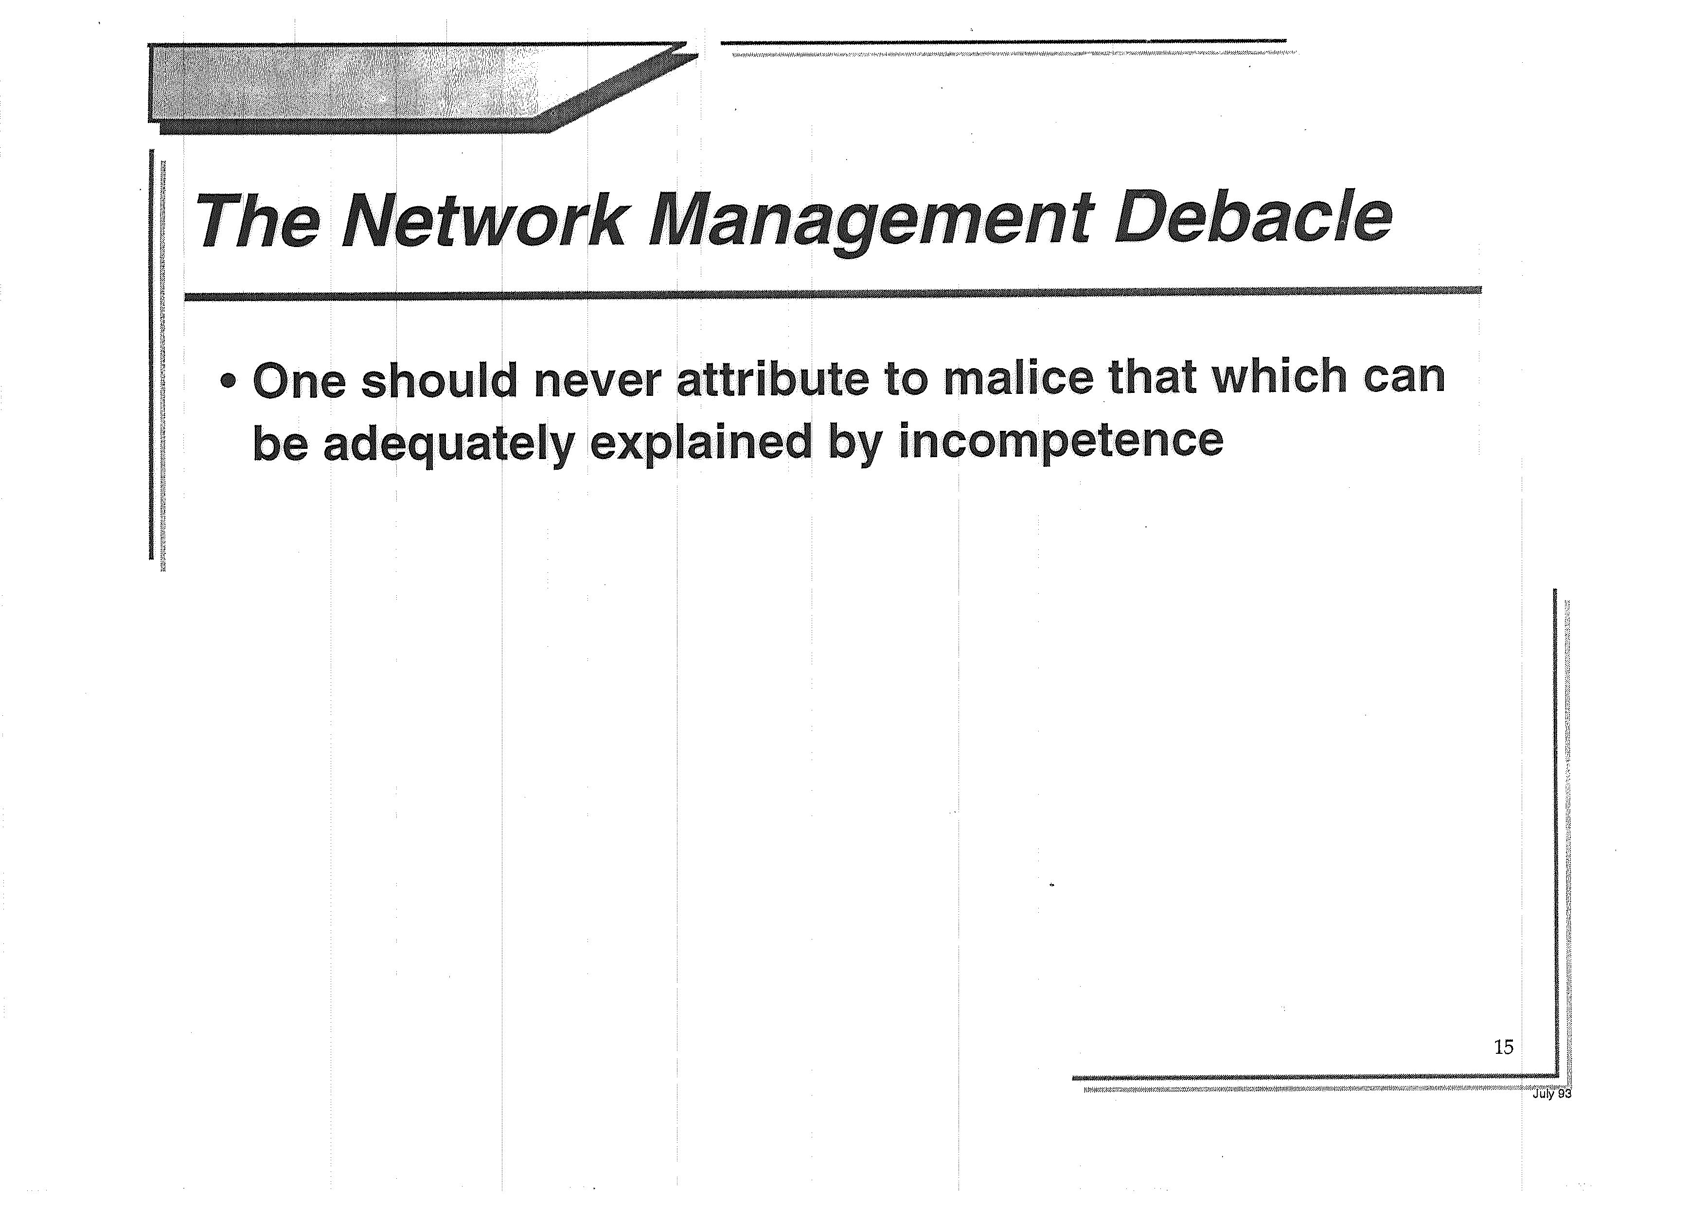

Slide 28
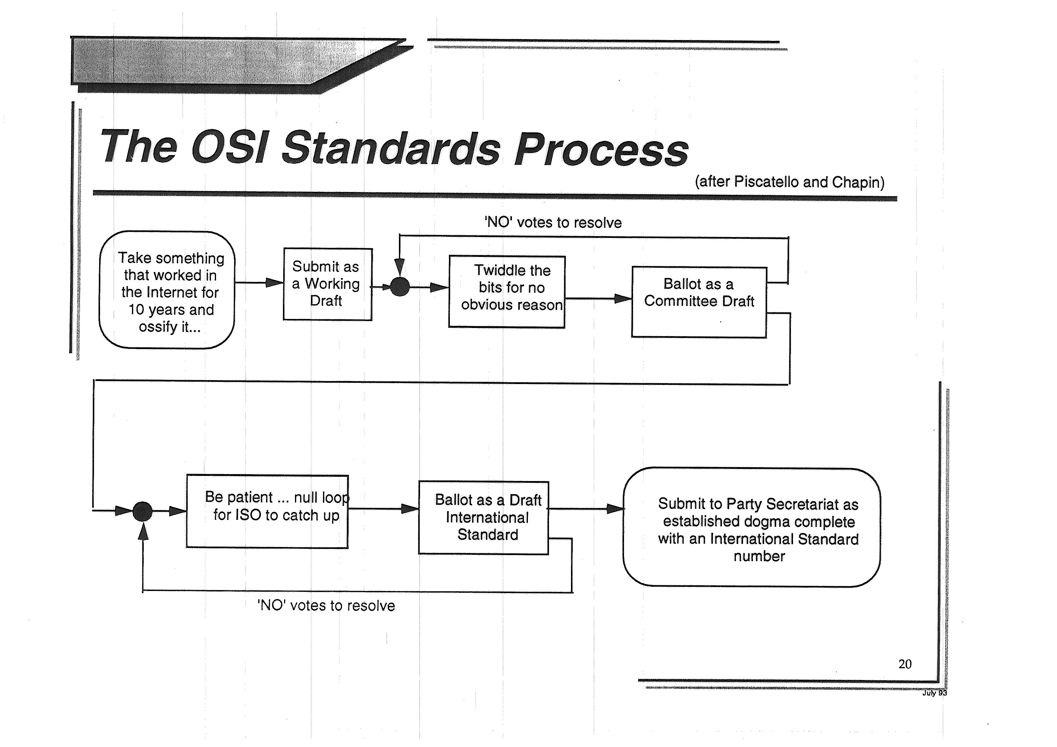

Slide 29
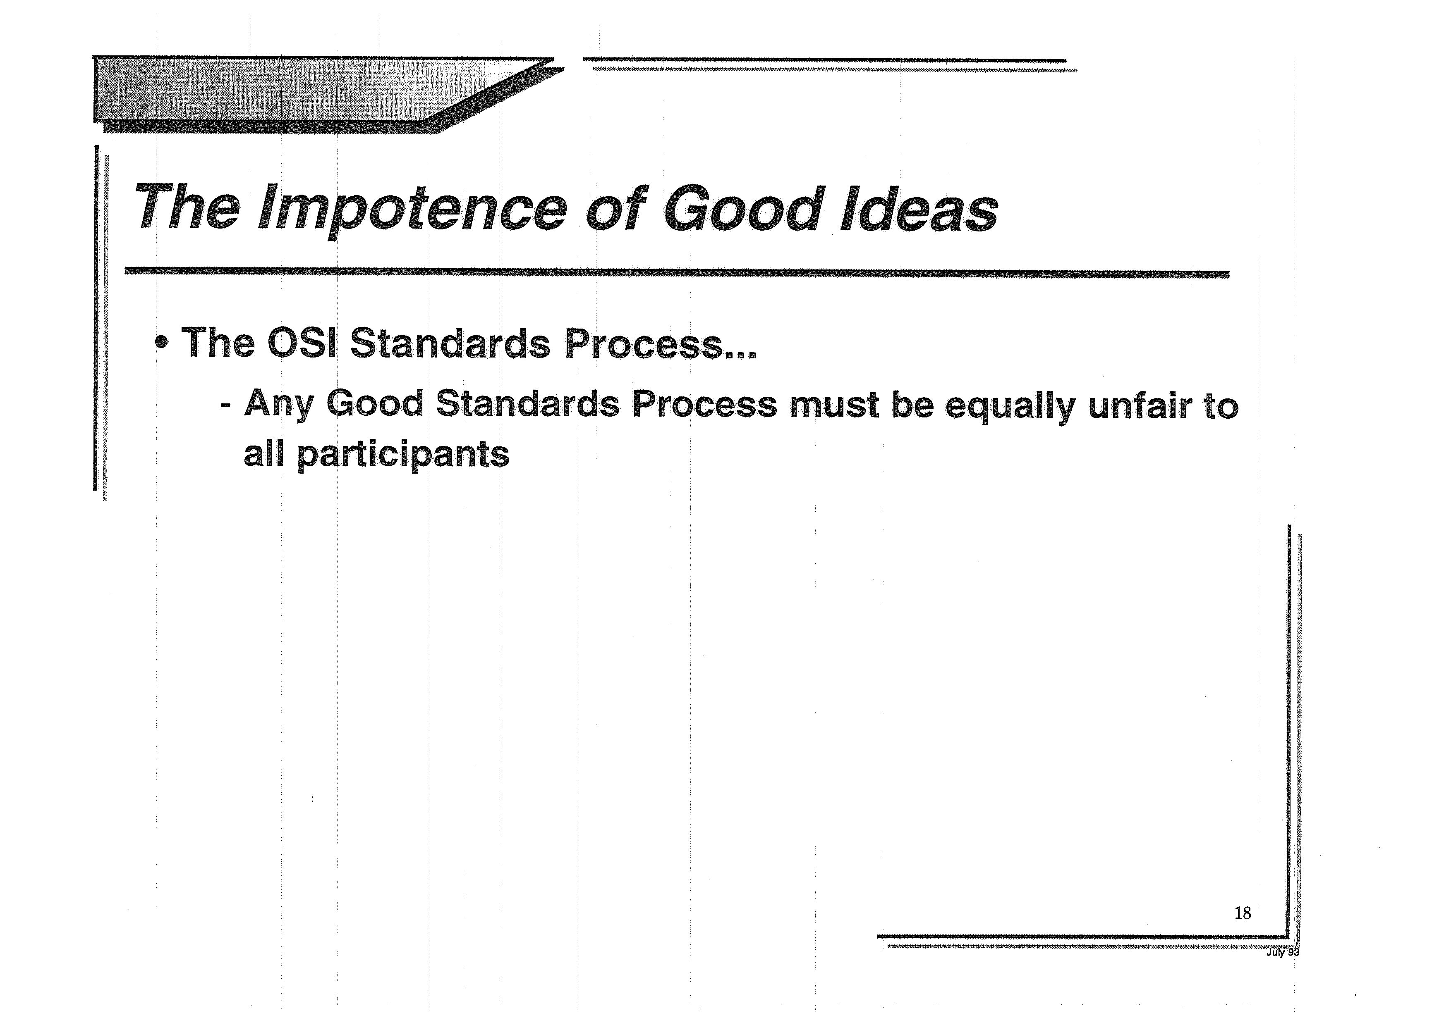

Slide 30
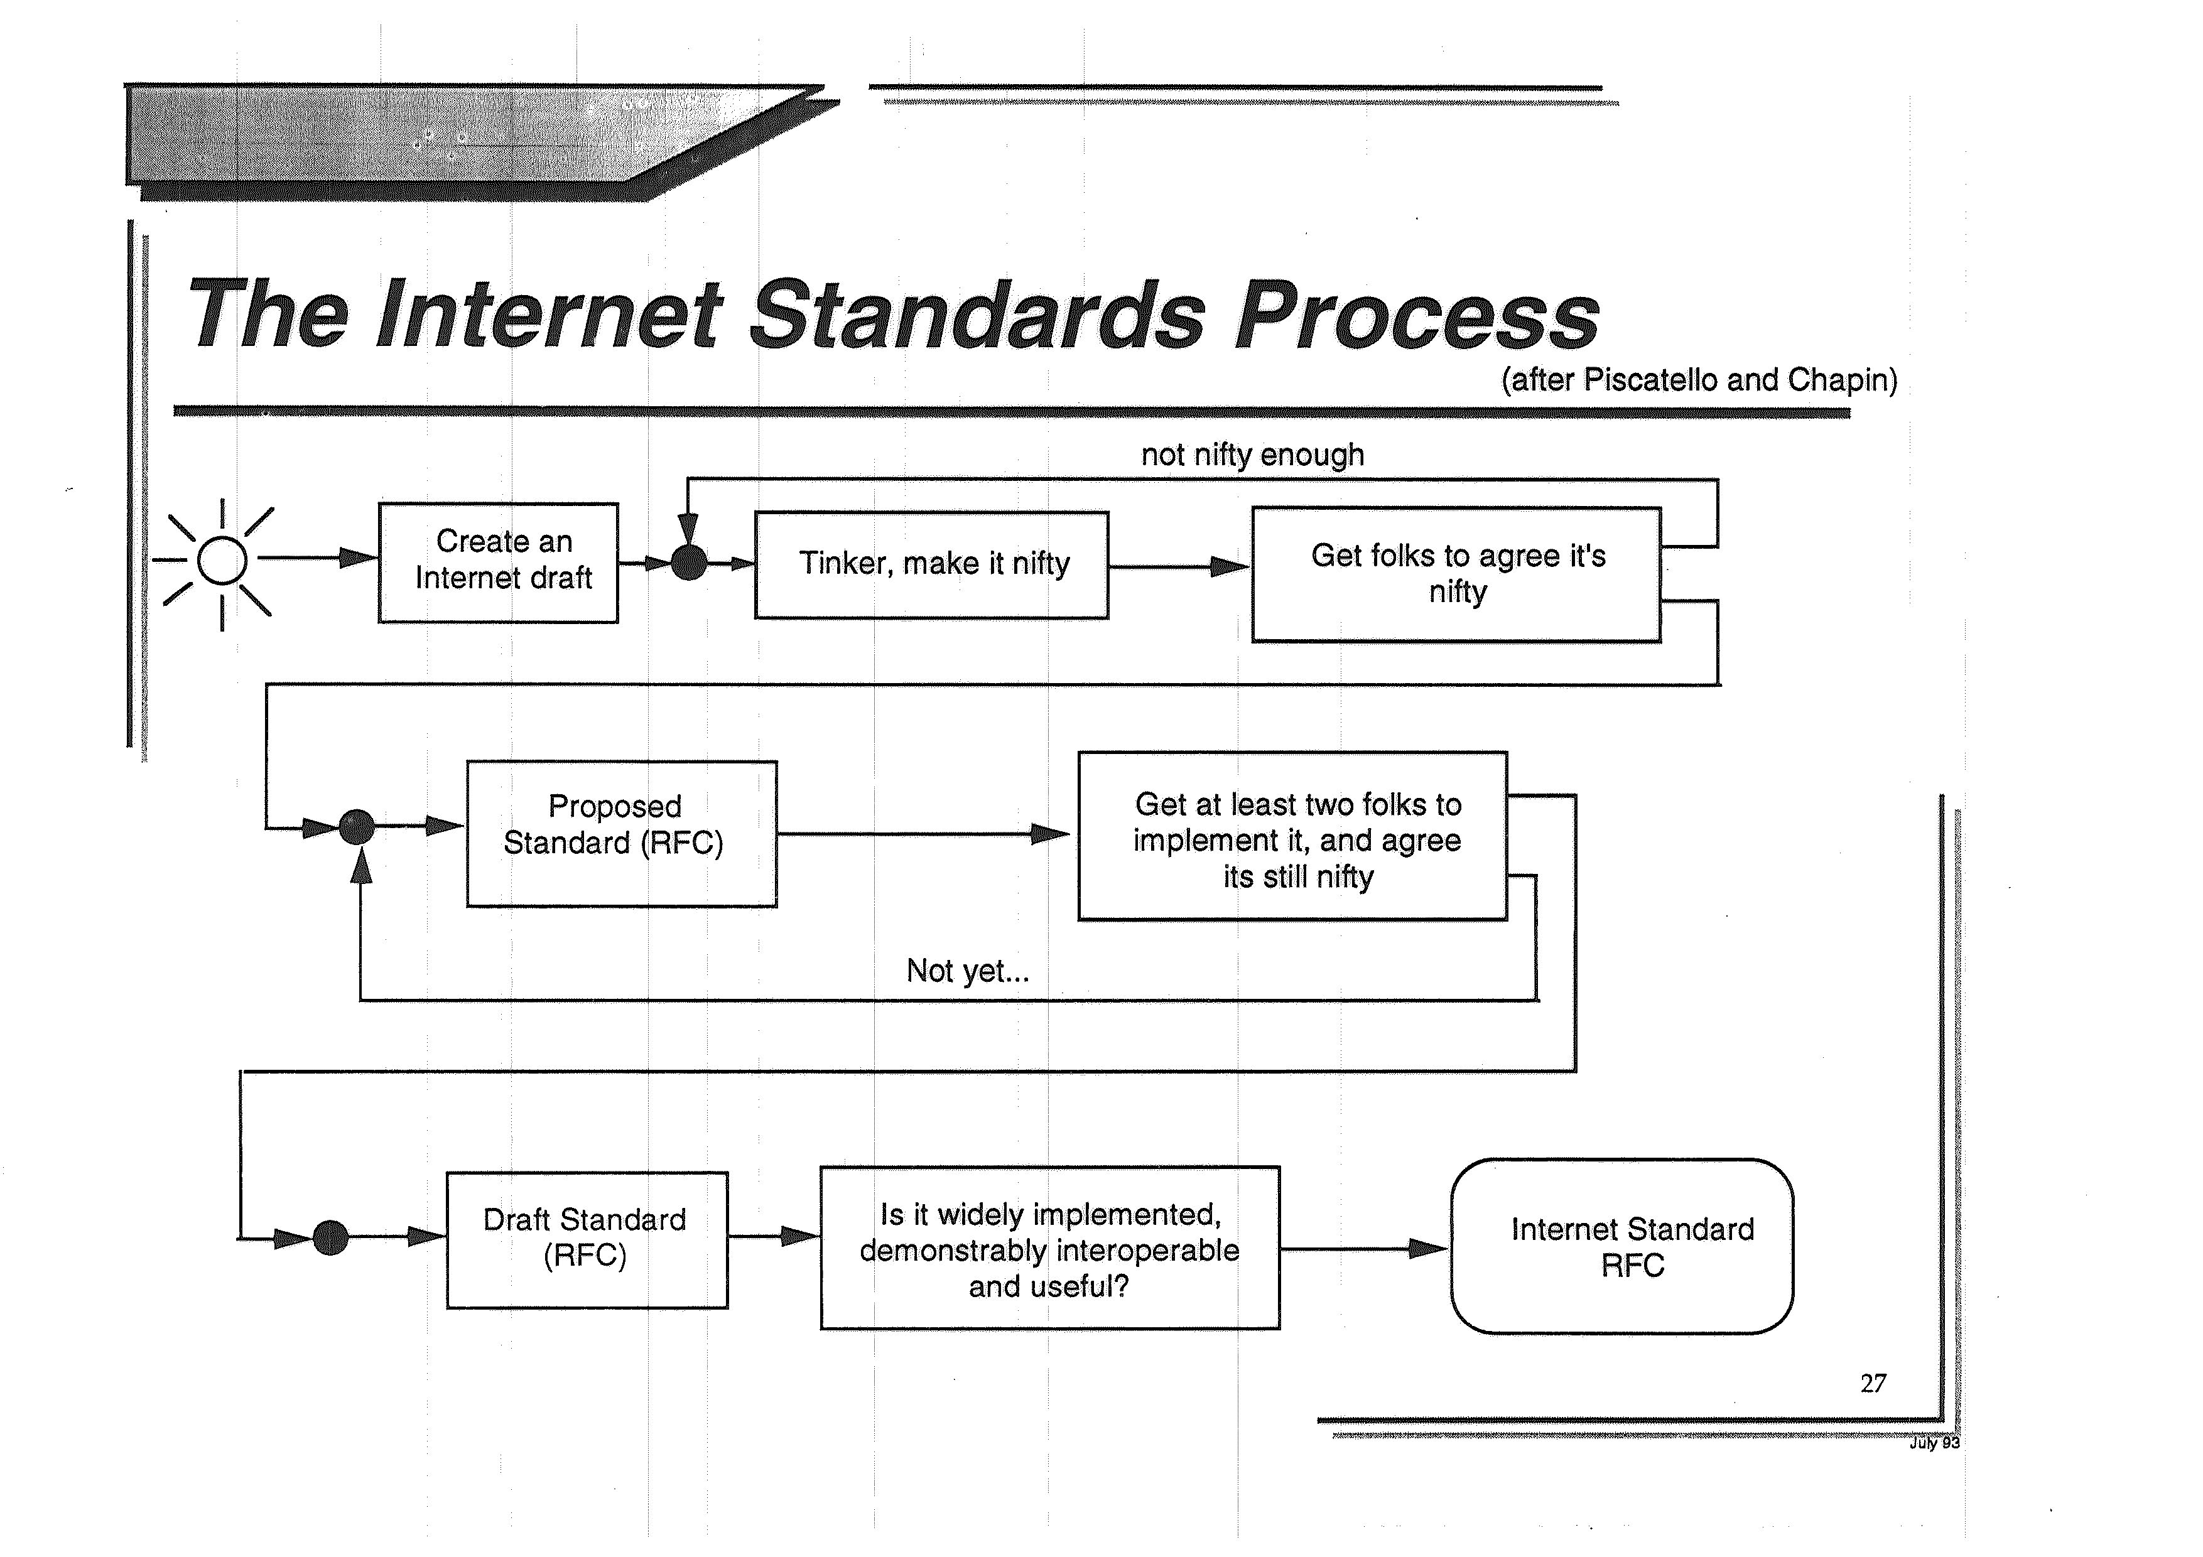

Slide 31
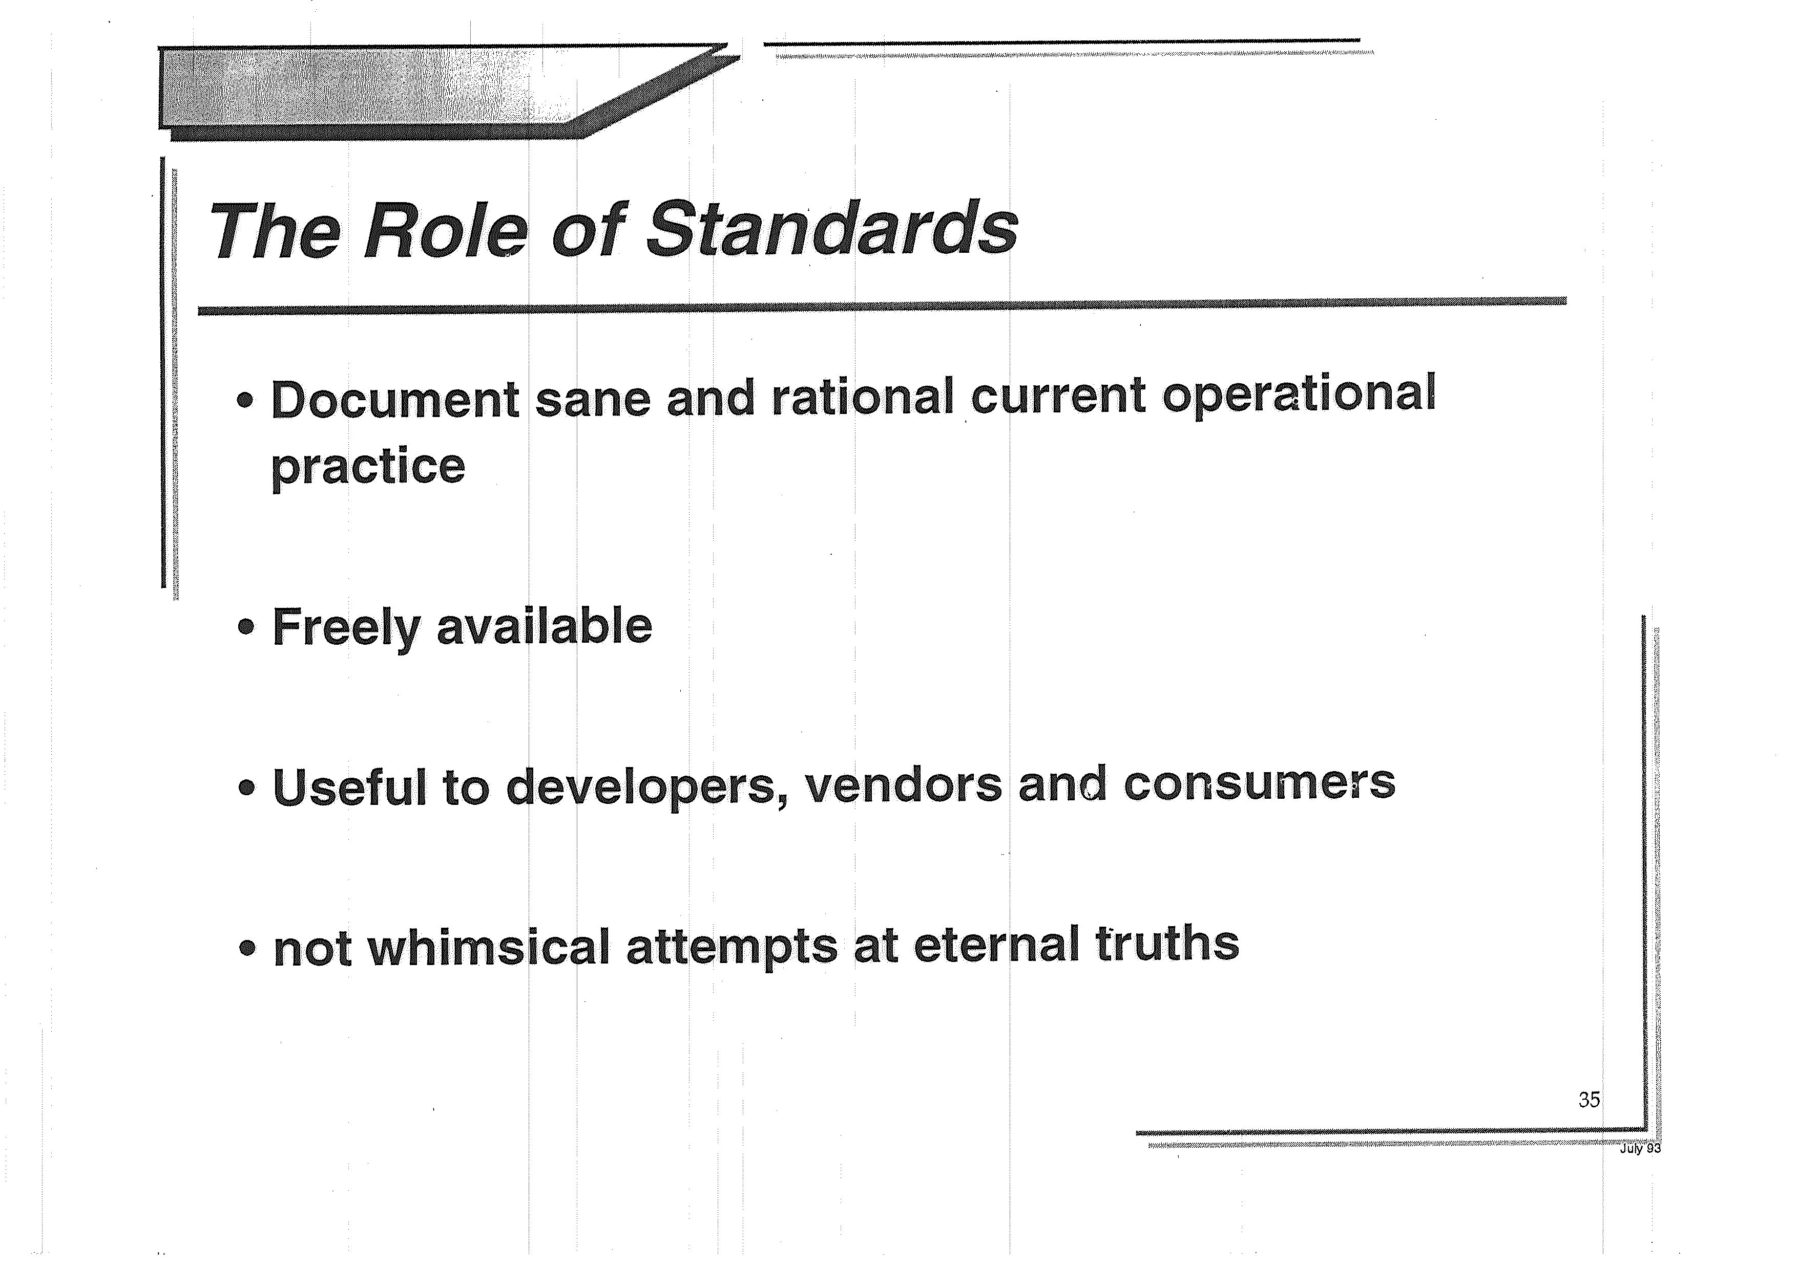

Slide 32
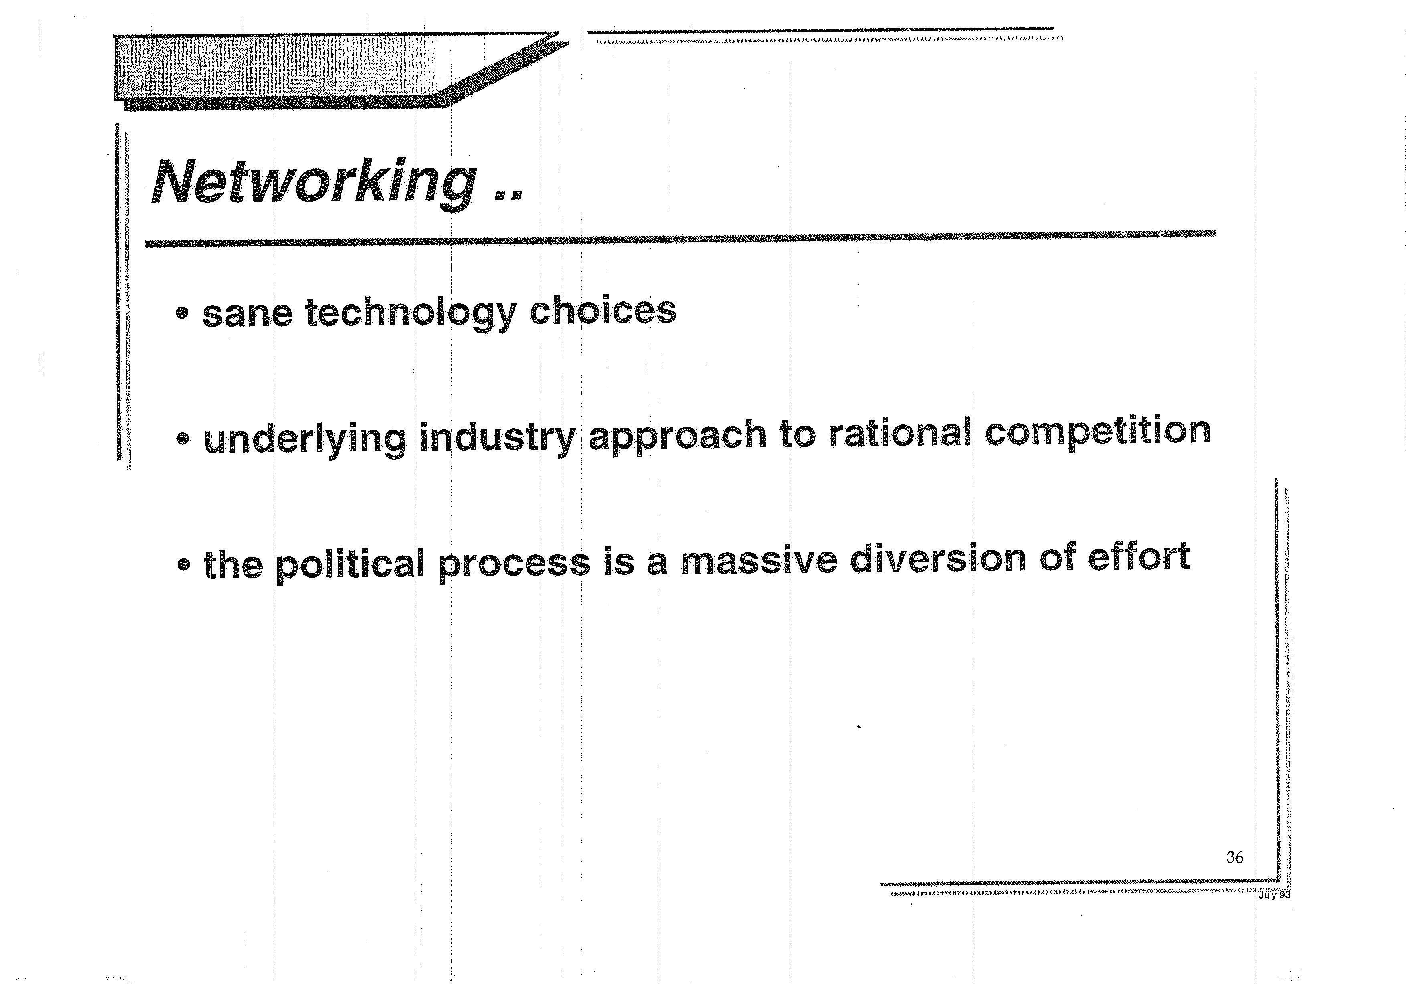

Slide 33
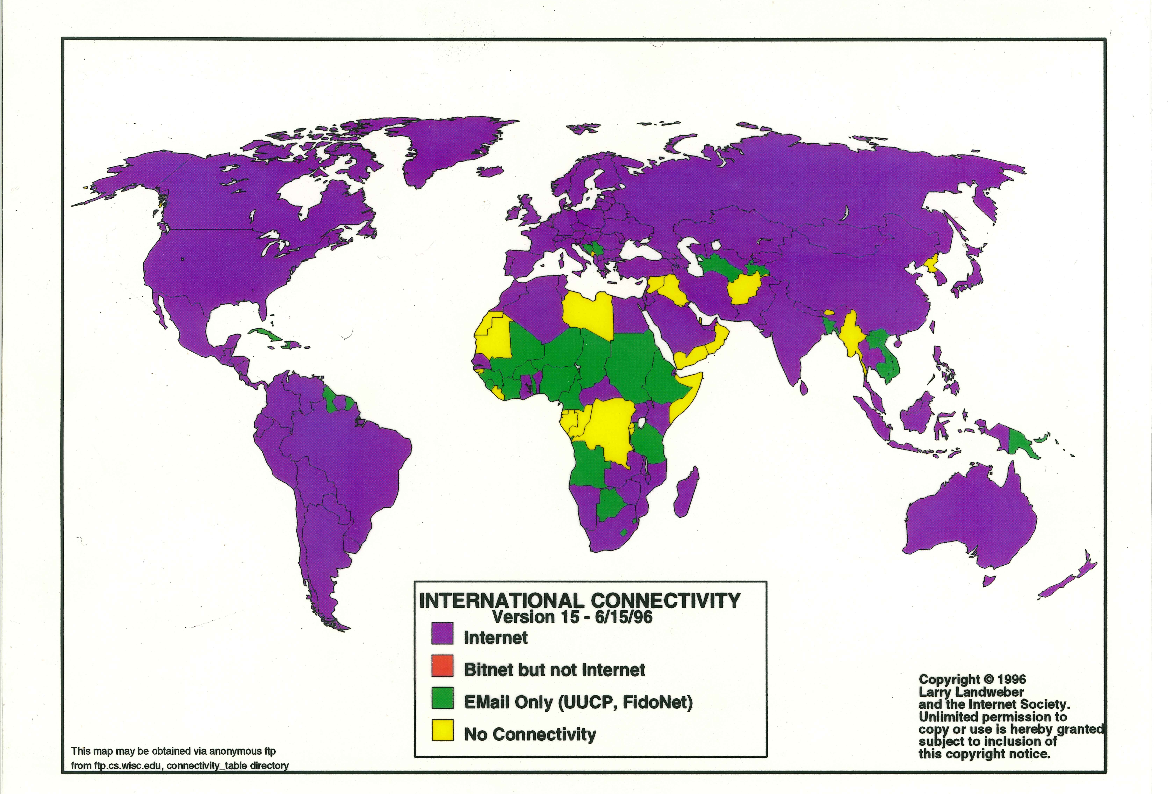
We had high hopes for the Internet

Slide 34
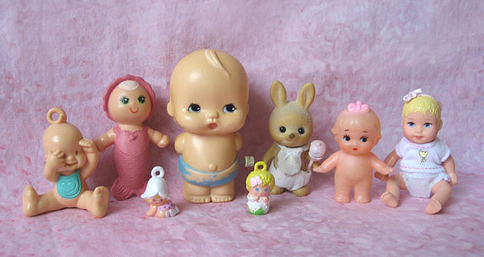
But we were a lot younger then
Photo Credit: Aimee Ray https://www.flickr.com/photos/merwing/516164481

Slide 35
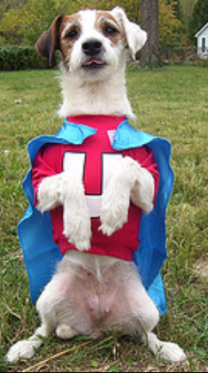
And we were the underdog
Photo Credit: https://www.flickr.com/photos/barrielynn/1817195121

Slide 36
Things are different now

Slide 37
Things are different now
We won

Slide 38
Things are different now
We won:
We won the protocol wars with OSI
We won the voice wars with telephony
We’re winning the content wars with television
Computers and the Internet are now everywhere…

Slide 39
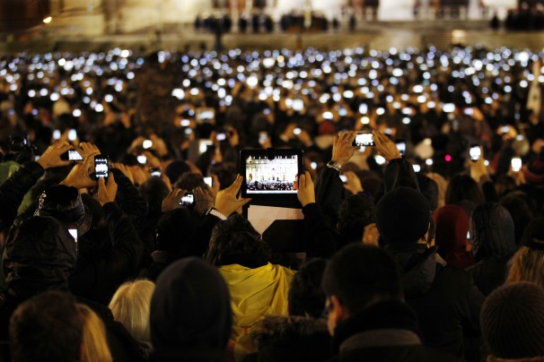
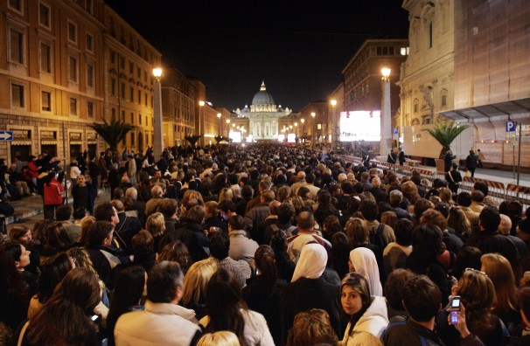
Recording everything
2005
2013

Slide 40
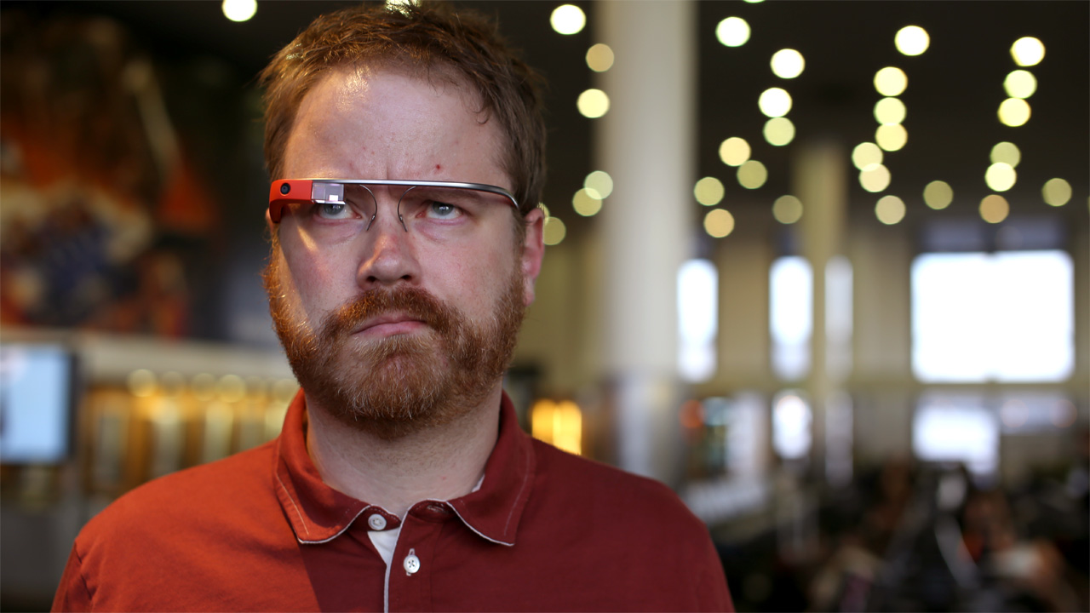
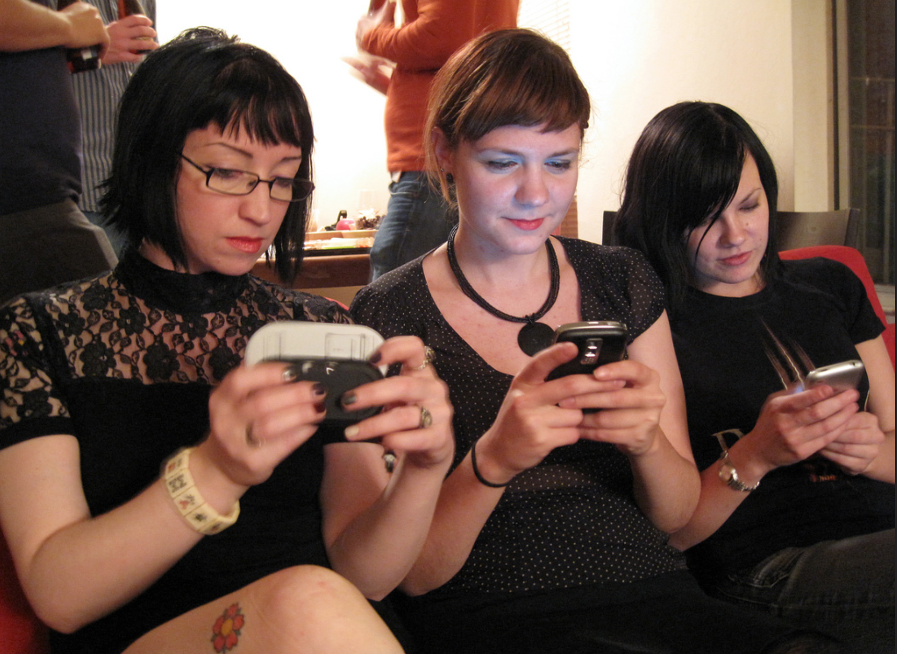
Always with us

Slide 41
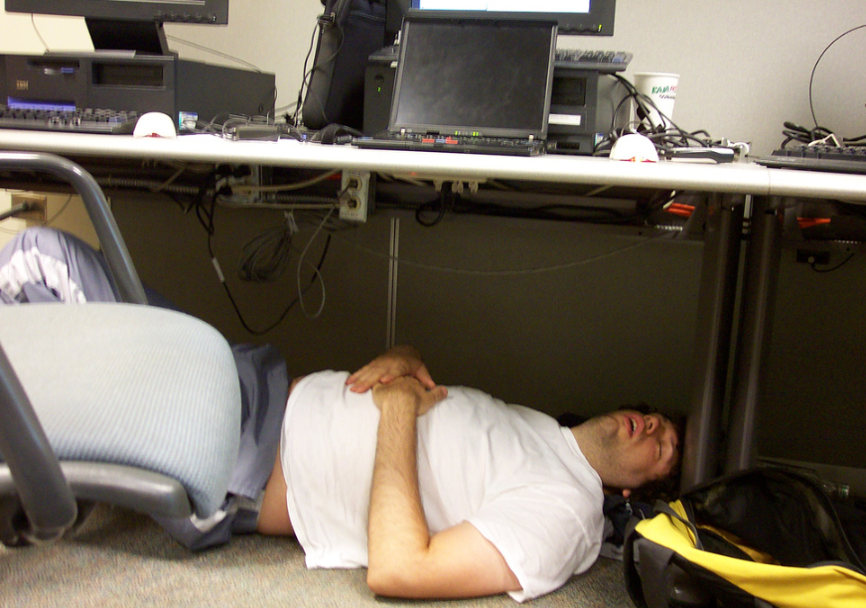
All the time
Photo Credit: Adam Goode: https://www.flickr.com/photos/explosivebolts/60622410/

Slide 42
And it sure looks like…

Slide 43
And it sure looks like…
WE are now the problem!

Slide 44
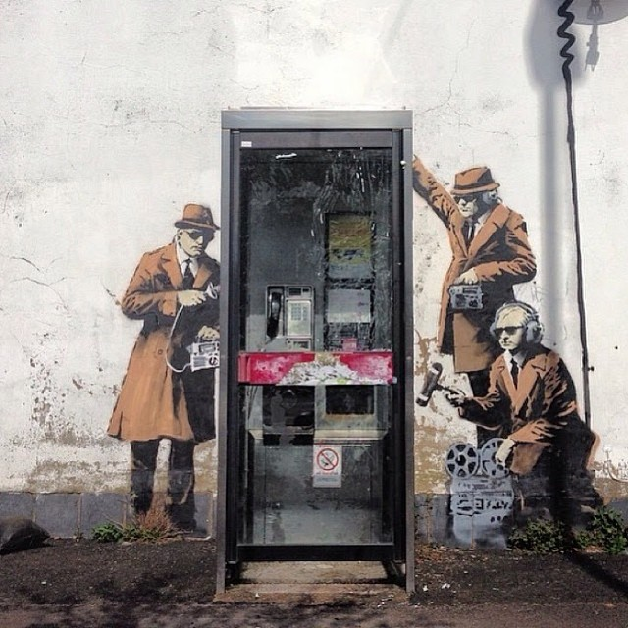
Street Art: Banksy

